Slide 1
Small Business Tax Summit
NFIB Research Center

Slide 2
Small Business Problems and Priorities
Problem | Rank | Mean | Percent "Critical" | Percent "Not a Problem" | 2016 Rank
Cost of Health Insurance | 1 | 2.31 | 50.6 | 8.0 | 1
Locating Qualified Employees | 2 | 3.17 | 30.5 | 13.1 | 10
Federal Taxes on Business Income | 3 | 3.28 | 20.1 | 8.2 | 3
Property Taxes (real, inventory or personal property) | 4 | 3.36 | 20.6 | 9.8 | 8
Finding and Keeping Skilled Employees | 5 | 3.37 | 25.5 | 13.2 | 14
Unreasonable Government Regulations | 6 | 3.42 | 18.8 | 8.6 | 2
State Taxes on Business Income | 7 | 3.46 | 18.7 | 10.9 | 9
Tax Complexity | 8 | 3.46 | 16.2 | 8.4 | 5
Uncertainty over Economic Conditions | 9 | 3.60 | 14.0 | 7.5 | 4
Uncertainty over Government Actions | 10 | 3.63 | 14.7 | 9.8 | 6
State/Local Paperwork | 11 | 3.74 | 11.3 | 10.3 | 11
Cost of Supplies/Inventories | 12 | 3.85 | 9.3 | 10.0 | 15
Frequent Changes in Federal Tax Laws and Rules | 13 | 3.86 | 10.8 | 12.1 | 7
Cost and Availability of Liability Insurance | 14 | 3.92 | 13.1 | 14.9 | 20
Federal Paperwork | 15 | 3.99 | 9.1 | 12.0 | 12

Slide 3
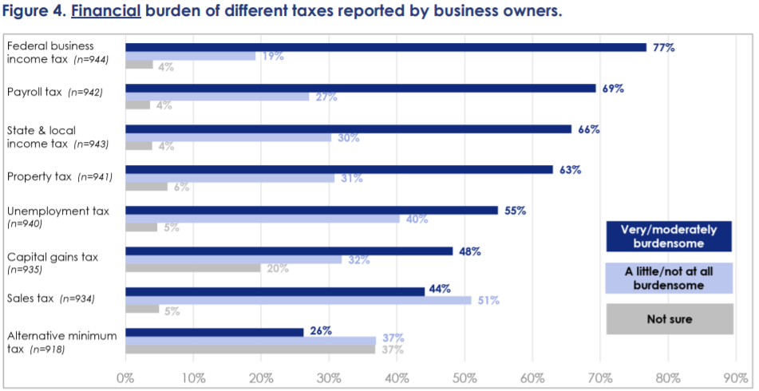

Slide 4
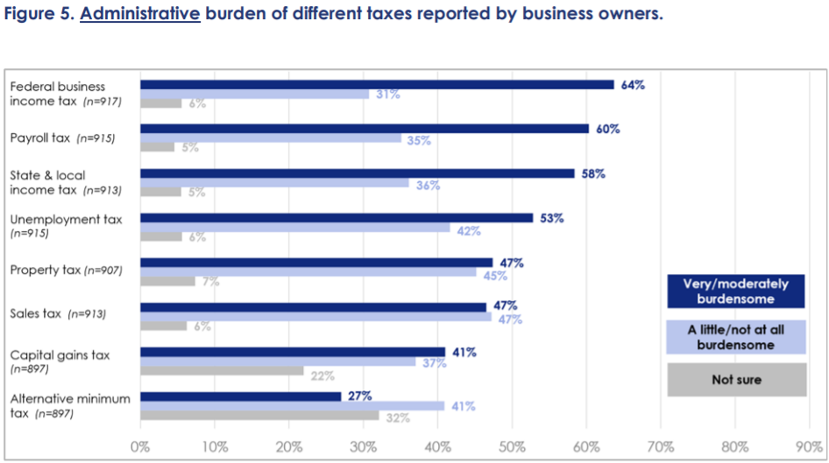

Slide 6
Nearly a quarter (22%) of small business owners have contacted or tried to contact the IRS for information related to their business(es) in the last 12 months. Among those who contacted the IRS about two-thirds (64%) reported their contacted with the IRS as not at all helpful.

Slide 7
When asked about preparing this year’s taxes, about half of small business owners (47%) reported that preparing their 2020 and 2021 taxes has been more difficult than it was pre-Covid.

Slide 8
About one-third of small business owners reported that they are planning to or have requested an extension for filing their 2021 tax return.

Slide 9
Small Business Tax Summit
NFIB Research Center

